Slide 1

6th Grade Accelerated Math
Unit 9, Lesson 10 Creating Histograms Volume 2, pg. 96

Slide 2


Benchmark
MA.6.DP.1.5
Create box plots and histograms to represent sets of numerical data within real-world contexts.
volume 2, pg. 96

Slide 3
Integrated Mathematical Thinking and Reasoning Standards
MA.K12.MTR.4.1 Engage in discussions that reflect on the mathematical thinking of self and others.
MA.K12.MTR.6.1 Assess the reasonableness of solutions.
MA.K12.MTR.7.1 Apply mathematics to real-world contexts.
volume 2, pg. 96

Slide 4

Learning Target
I can create a histogram to represent data.
volume 2, pg. 96

Slide 5

Warm-Up
volume 2, pg. 97

Slide 6
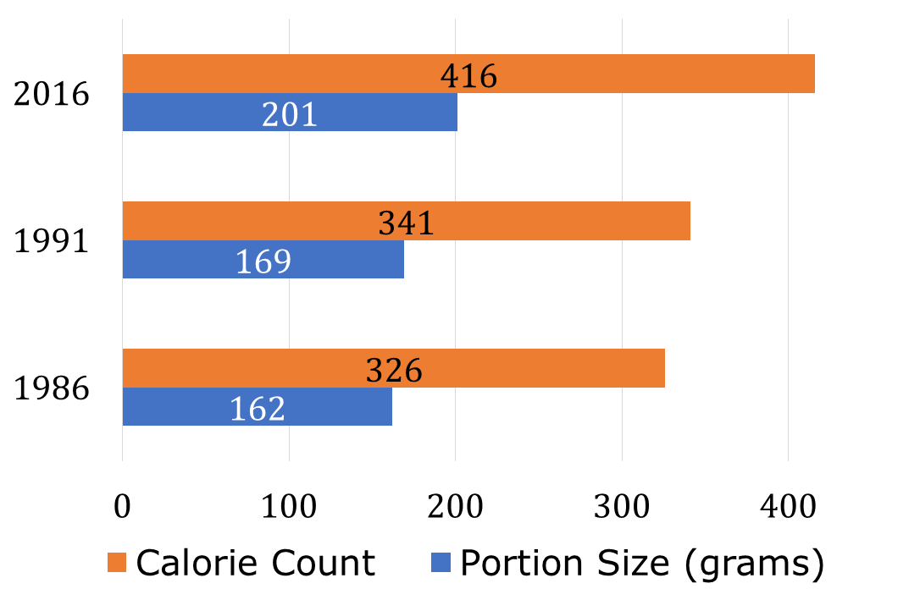
9.10.1 Warm-Up: Notice and Wonder
The portion size and calorie count of fast-food menu items have changed over time.
What are two things you notice about the graph?
What is one thing you wonder about the graph?
volume 2, pg. 97

Slide 7

Guided Instruction
volume 2, pg. 97

Slide 8
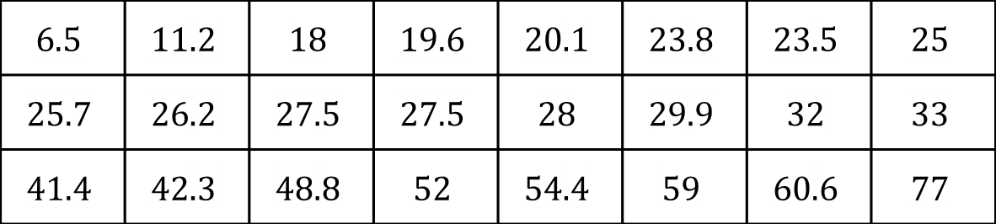
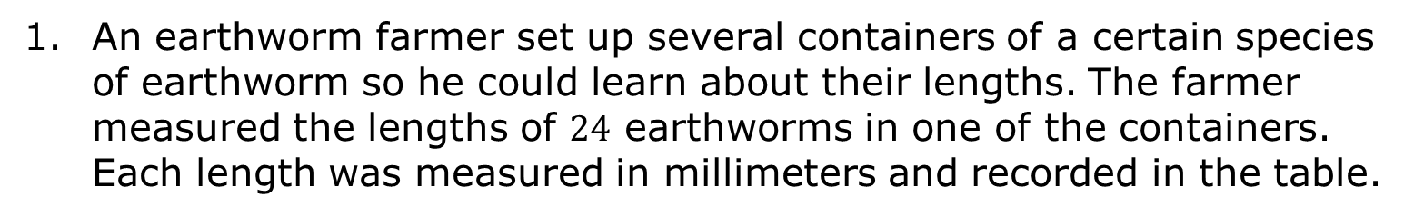
9.10.2 Guided Instruction: Elements of Creating Histograms
An earthworm farmer set up several containers of a certain species of earthworm so he could learn about their lengths. The farmer measured the lengths of $24$ earthworms in one of the containers. Each length was measured in millimeters and recorded in the table.
$$6.5$$ | $$11.2$$ | $$18$$ | $$19.6$$ | $$20.1$$ | $$23.8$$ | $$23.5$$ | $$25$$
$$25.7$$ | $$26.2$$ | $$27.5$$ | $$27.5$$ | $$28$$ | $$29.9$$ | $$32$$ | $$33$$
$$41.4$$ | $$42.3$$ | $$48.8$$ | $$52$$ | $$54.4$$ | $$59$$ | $$60.6$$ | $$77$$
Work with your partner to collect the pieces needed to create a histogram.
The range of the data is ___________.
volume 2, pg. 97

Slide 9
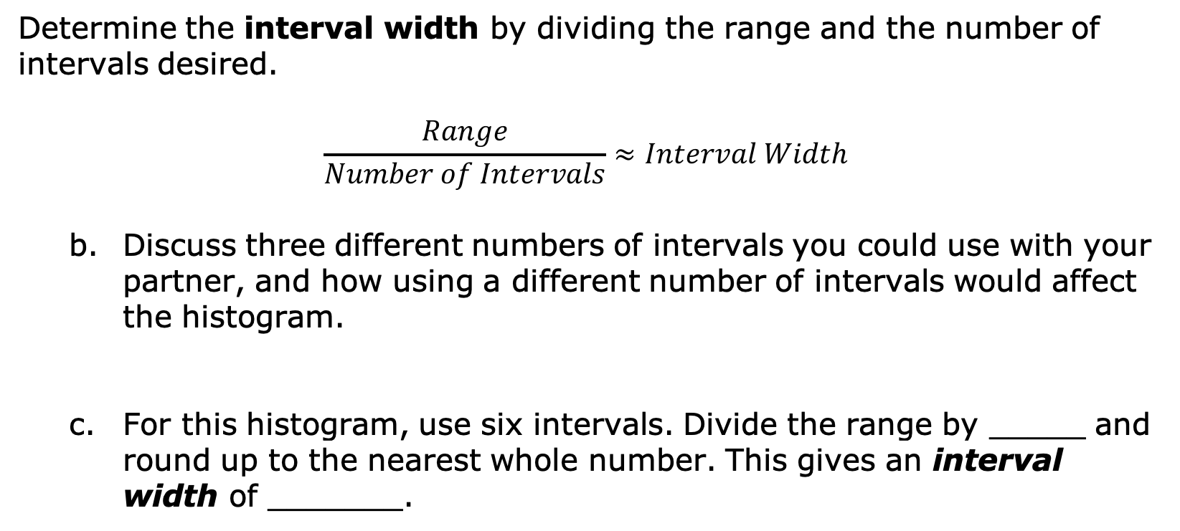
Determine the interval width by dividing the range and the number of intervals desired.
$$\frac{Range}{Number of Intervals}≈Interval Width$$
Discuss three different numbers of intervals you could use with your partner, and how using a different number of intervals would affect the histogram.
For this histogram, use six intervals. Divide the range by _____ and round up to the nearest whole number. This gives an interval width of _______.
volume 2, pg. 97

Slide 10

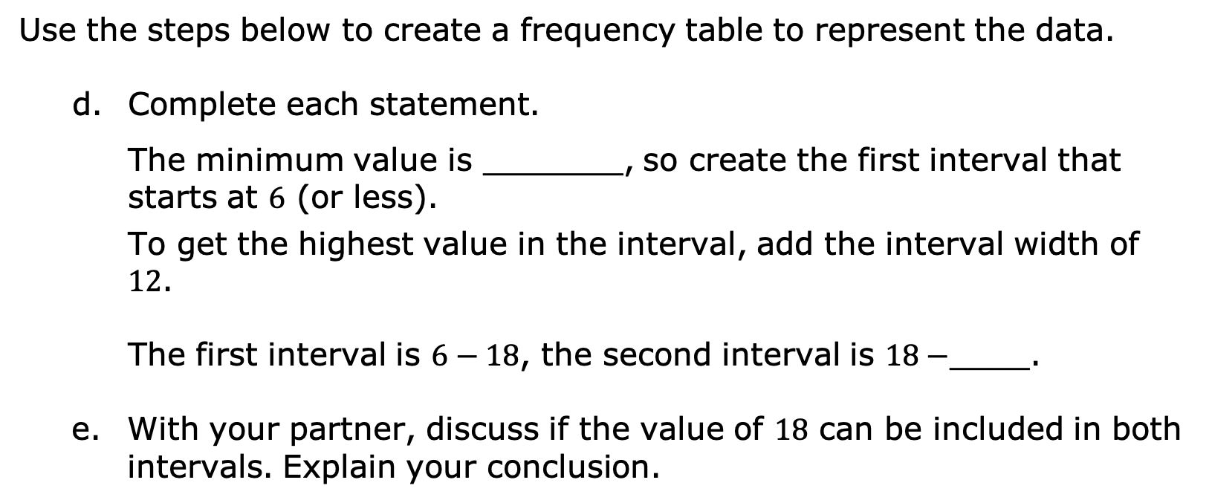
A frequency table is a table that shows how often each item, number, or range of numbers occurs in a set of data.
Use the steps below to create a frequency table to represent the data.
Complete each statement.
The minimum value is _______, so create the first interval that starts at $6$ (or less).
To get the highest value in the interval, add the interval width of $12$.
The first interval is $6−18$, the second interval is $18−$____.
With your partner, discuss if the value of $18$ can be included in both intervals. Explain your conclusion.
volume 2, pg. 98

Slide 11
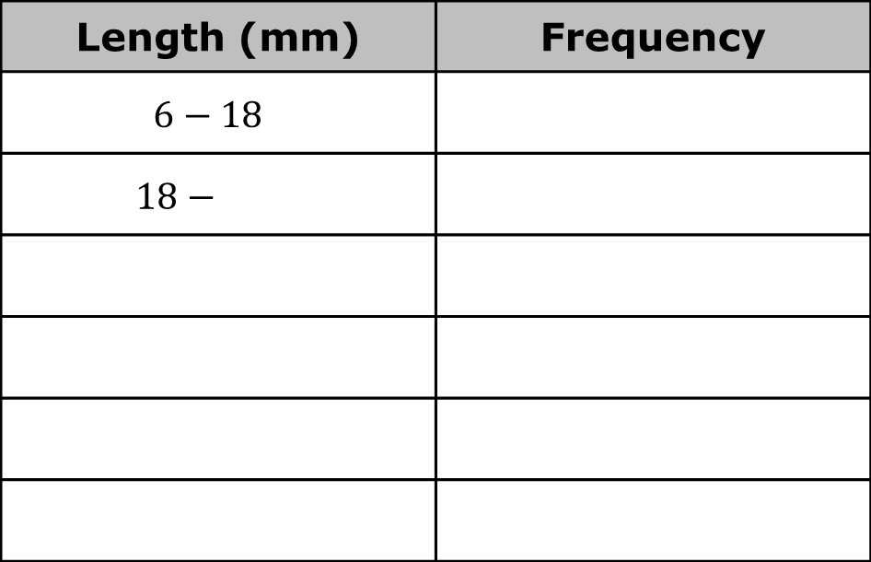
Complete the Length (mm) column of the table shown to indicate the intervals.
With your partner, determine the frequency values and fill in the Frequency column of the table.
Length (mm) | Frequency
$$6−18$$
$$18−$$
volume 2, pg. 98

Slide 12
In a histogram, the bars touch. The variable measured is placed on the horizontal axis, and frequency is placed on the vertical axis.
Label the horizontal and vertical axis of the grid below. Then, use the grid to create the histogram to display the lengths of earthworms in millimeters.
volume 2, pg. 98

Slide 13
The same data could be displayed in this histogram.
With your partner, discuss the differences you notice about this histogram from the one you created.
Explain which histogram better displays the data.
volume 2, pg. 99

Slide 14
Ask two classmates the reasons they listed for which histogram better displays the data. Record their choice and write your summary of their reason. You are the only person who should write in the first two columns of the table. Have the person initial next to your summary stating that your summary was correct.
Explain whether the data has the characteristics that will result in truthful data.
Histogram Choice | My Summary of their Reason | Initials
volume 2, pg. 99

Slide 15

Guided Practice
volume 2, pg. 100

Slide 16

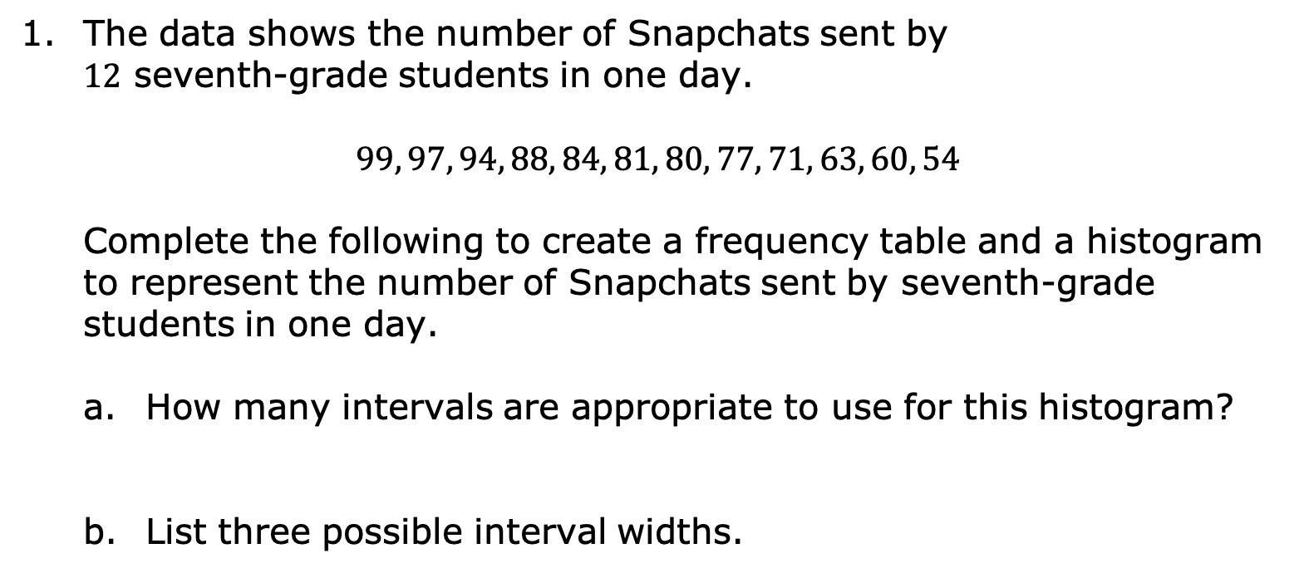
9.10.3 Guided Practice: Creating Histograms
The data shows the number of Snapchats sent by $12$ seventh-grade students in one day.
$$99, 97, 94, 88, 84, 81, 80, 77, 71, 63, 60, 54$$
Complete the following to create a frequency table and a histogram to represent the number of Snapchats sent by seventh-grade students in one day.
How many intervals are appropriate to use for this histogram?
List three possible interval widths.
volume 2, pg. 100

Slide 17
Using one of the possible interval widths, create the frequency table and histogram of the data. Make sure to label both the horizontal and vertical axis of the histogram.
Snapchats | Frequency
volume 2, pg. 100

Slide 18
Find a classmate who used a different interval width and compare your histograms. Summarize your discussion on what you notice about the two different graphs.
volume 2, pg. 100

Slide 19
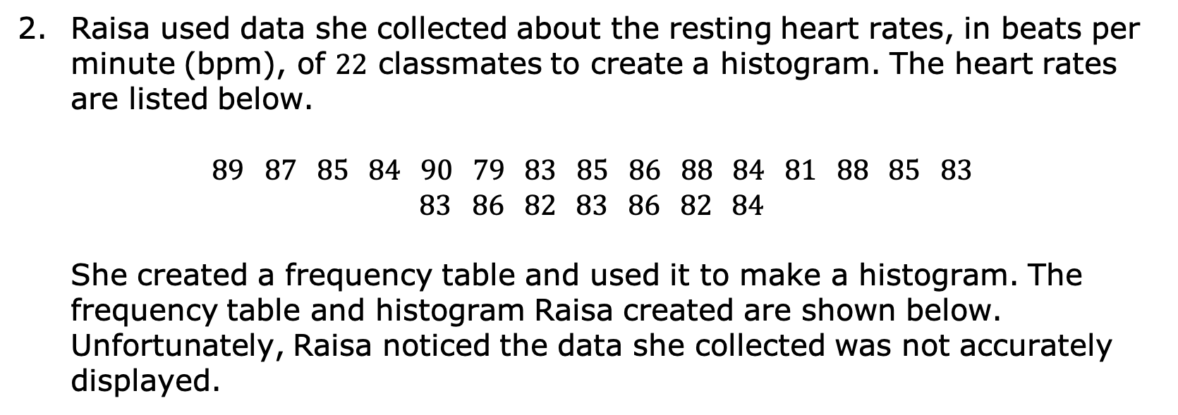
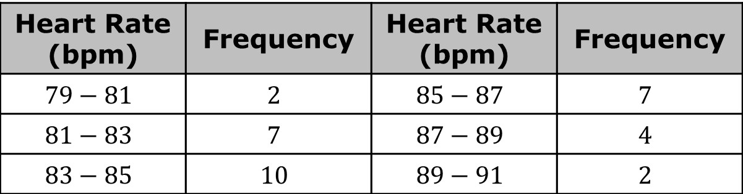
Raisa used data she collected about the resting heart rates, in beats per minute (bpm), of 22 classmates to create a histogram. The heart rates are listed below.
$87 85 84 90 79 83 85 86 88 84 81 88 85 83$
$86 82 83 86 82 84$
She created a frequency table and used it to make a histogram. The frequency table and histogram Raisa created are shown below. Unfortunately, Raisa noticed the data she collected was not accurately displayed.
Heart Rate (bpm) | Frequency | Heart Rate (bpm) | Frequency
$$79−81$$ | $$2$$ | $$85−87$$ | $$7$$
$$81−83$$ | $$7$$ | $$87−89$$ | $$4$$
$$83−85$$ | $$10$$ | $$89−91$$ | $$2$$
volume 2, pg. 101

Slide 20
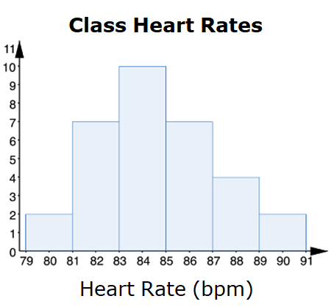
Explain what Raisa did wrong.
volume 2, pg. 101

Slide 21
Correct Raisa’s mistake and create a frequency table and histogram that correctly displays the data she collected.
Heart Rate (bpm) | Frequency | Heart Rate (bpm) | Frequency
volume 2, pg. 101

Slide 22

Your Turn
volume 2, pg. 102

Slide 23
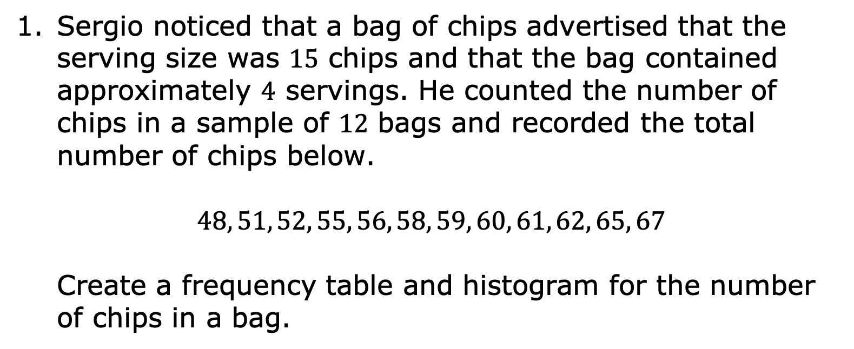
9.10.4 Your Turn!
Sergio noticed that a bag of chips advertised that the serving size was $15$ chips and that the bag contained approximately $4$ servings. He counted the number of chips in a sample of $12$ bags and recorded the total number of chips below.
$$48, 51, 52, 55, 56, 58, 59, 60, 61, 62, 65, 67$$
Create a frequency table and histogram for the number of chips in a bag.
volume 2, pg. 102

Slide 24
Number of Chips | Frequency
volume 2, pg. 102

Slide 25

Wrap-Up
volume 2, pg. 102

Slide 26

9.10.5 Wrap-Up: Reflection
What was the muddiest (most difficult or confusing) point in today’s lesson on creating histograms?
volume 2, pg. 102

